Slide 1
Loaning items from different institutions to different patrons in an Alma Consortium Network Zone environment (using the Fulfillment Network)
Yoel Kortick
Senior Librarian

Slide 2

Agenda
What will we show here?
The specific example here
The flow in Primo for the end user
Flow for staff in Alma

Slide 3
What will we show here?

Slide 4
What we will show here?
Patron requests item from other institution and loans and returns at his or her home institution
We will show an Alma Fulfillment Network with the following situation:
There is a consortium of several member institutions, for example member A, B and C.
Patron X in member A wants to loan title Y. Patron X discovers that his or her institution does not have title Y, but that it is available in another institution (institution C).
Patron X makes a request for title Y. Institution C gets the request and transits the item to institution A and institution A loans it to Patron X
Patron X returns the item at institution A which then transits it back to Institution C. Institution C checks it in.
Process is done.

Slide 5
What will we not show here? (though it is possible)
Patron is a “walk in borrower” at an institution which is not his or her home institution
There is a consortium of several member institutions, for example member A, B and C.
Patron X in member A wants to loan title Y. Patron X discovers that his or her institution does not have title Y, but that it is available in another institution (institution C).
Patron X goes to institution C, takes title from shelf, and approaches the circulation desk.
Patron X get’s registered at institution C as a walk-in borrower.
Patron X either
  Returns the item at institution C (owning institution)
  Returns the item at institution A (patron home institution) which then transits it to institution C which checks it in.
Process is done.

Slide 6
The specific example here

Slide 7
The specific example here
In the example here we have a network zone and three member institutions:
Member / Network | Name | Inst. Code
Network | Ex Libris University Consortium | EXLDEMO2_INST
Member | Alma University | EXLDEV1_INST
Member | Open University | EXLDEMO3_INST
Member | University of Knowledge | EXLDEMO1_INST

Slide 8

The specific example here
Network Zone
Ex Libris University Consortium
Member Institution
Alma University
Member Institution
Open University
Member Institution
University of Knowledge

Slide 9
The specific example here
Title “One frog can make a difference: Kermit's guide to life in the '90s / by Kermit the Frog, as told to Robert P. Riger” is in the member “University of Knowledge” and not in any other members.
Patron “Alicia Chen” is registered in member “Alma University” and has a user group which is allowed to request from other institutions

Slide 10
The flow in Primo for the end user

Slide 11
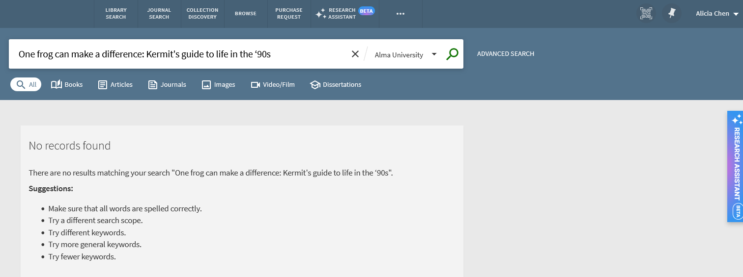
The flow in Primo for the end user
Alicia Chen logs into Primo and searches the search profile slot “Alma University” for title “One frog can make a difference: Kermit's guide to life in the ‘90s”
She gets no results.

Slide 12
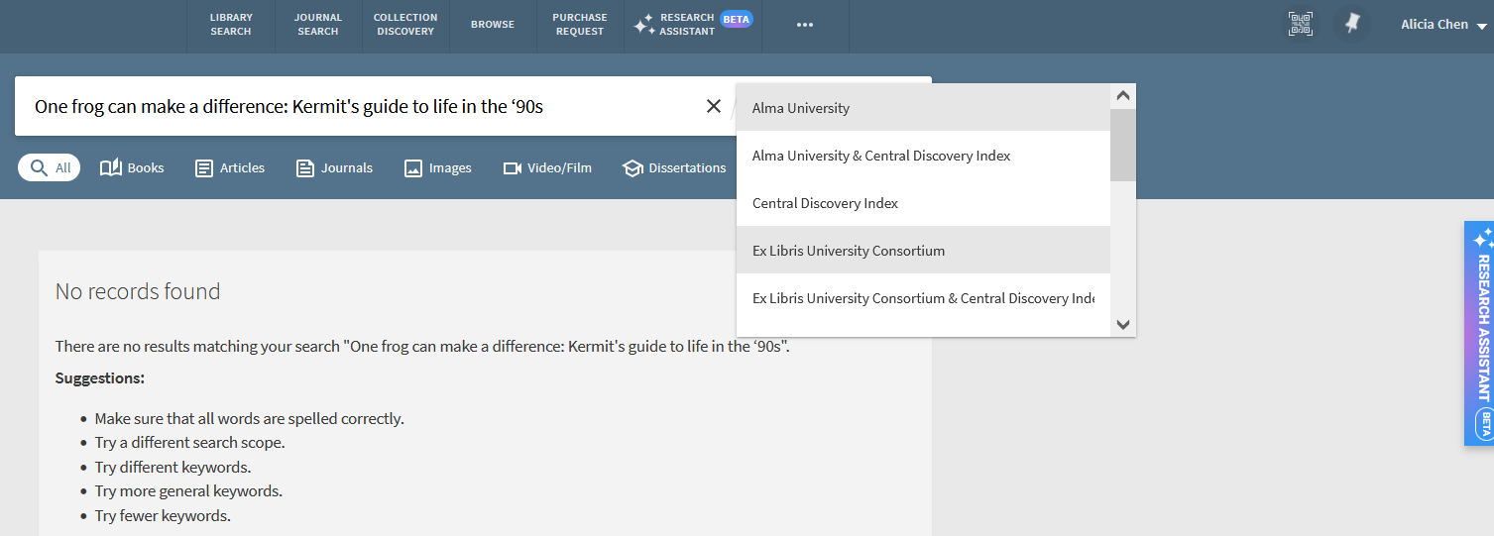
The flow in Primo for the end user
Because Alicia got no results she decides to search the network view
The names of these search profile slots are fully configurable by the institution

Slide 13
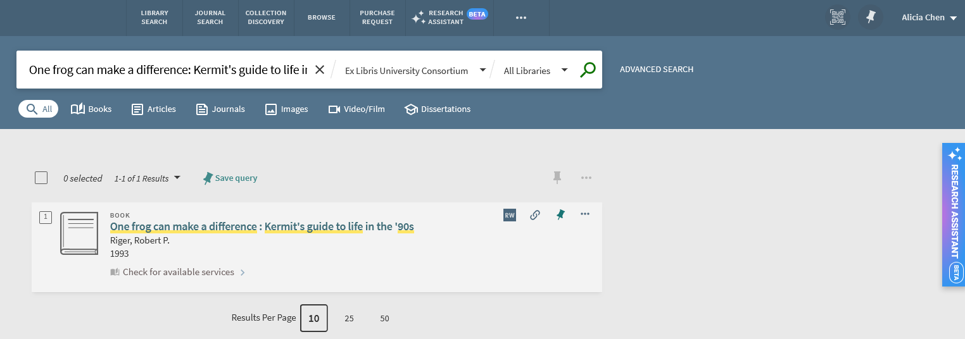
The flow in Primo for the end user
Alicia sees that it exists in the network view.
She clicks “Check for available services”

Slide 14
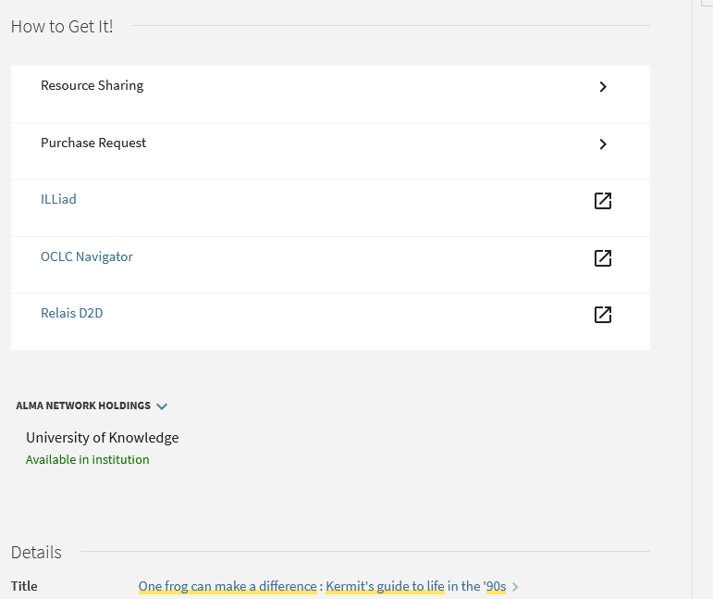
The flow in Primo for the end user
After clicking “Check Available Services” Alicia Clicks “Resource Sharing”
These other options can be removed (if desired)
Alicia sees which other institutions have the item

Slide 15
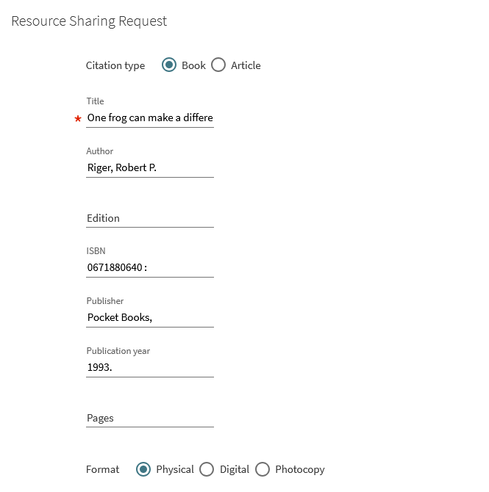
The flow in Primo for the end user
This is the resource sharing request form
Bibliographic information is automatically filled in

Slide 16
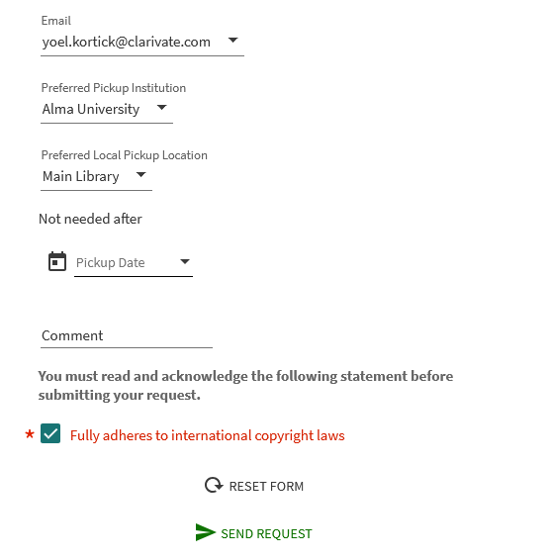
The flow in Primo for the end user
Can choose institution and library for pickup. Defaults to home institution
Send request

Slide 17
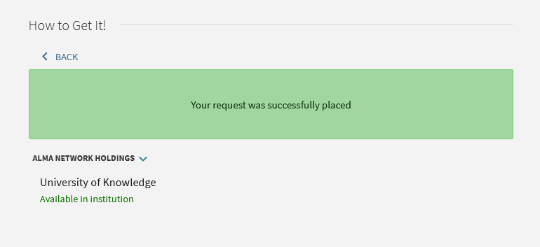
The flow in Primo for the end user
The request is placed

Slide 18
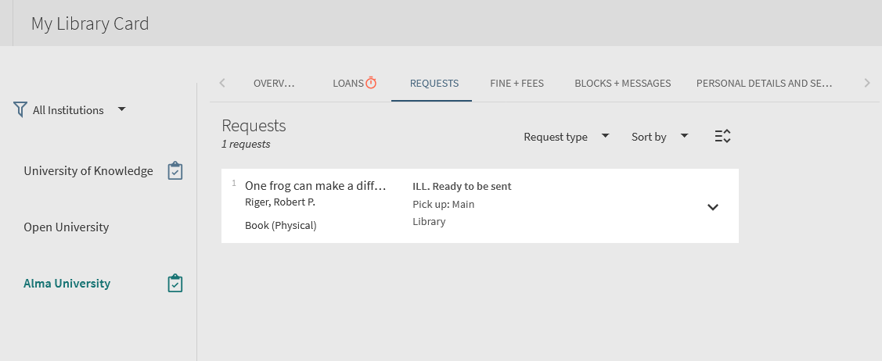
The flow in Primo for the end user
The patron can see the request in “My Library Card”

Slide 19
Flow for staff in Alma

Slide 20
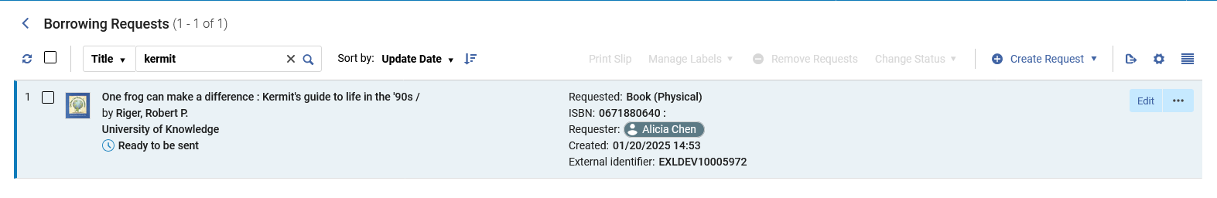
Flow for staff in Alma
In Alma University at “Fulfillment > Resource Sharing > Borrowing Requests” the request appears.
The Resource sharing request appears for the staff user and enters the regular desired flow (which will not be expounded upon in depth here)
Now it is ready to be sent

Slide 21
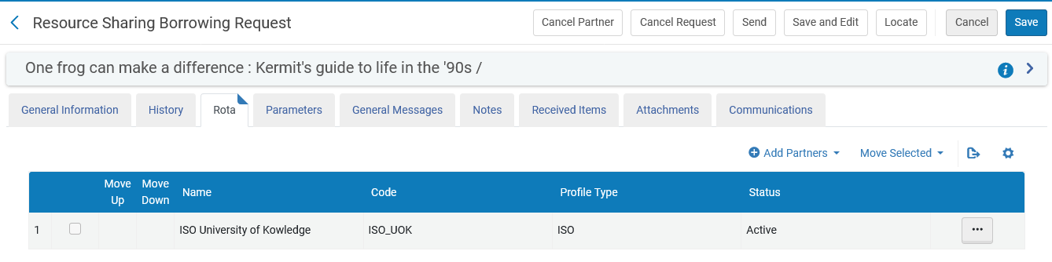
Flow for staff in Alma
The Borrowing Request has University of Knowledge in the Rota

Slide 22
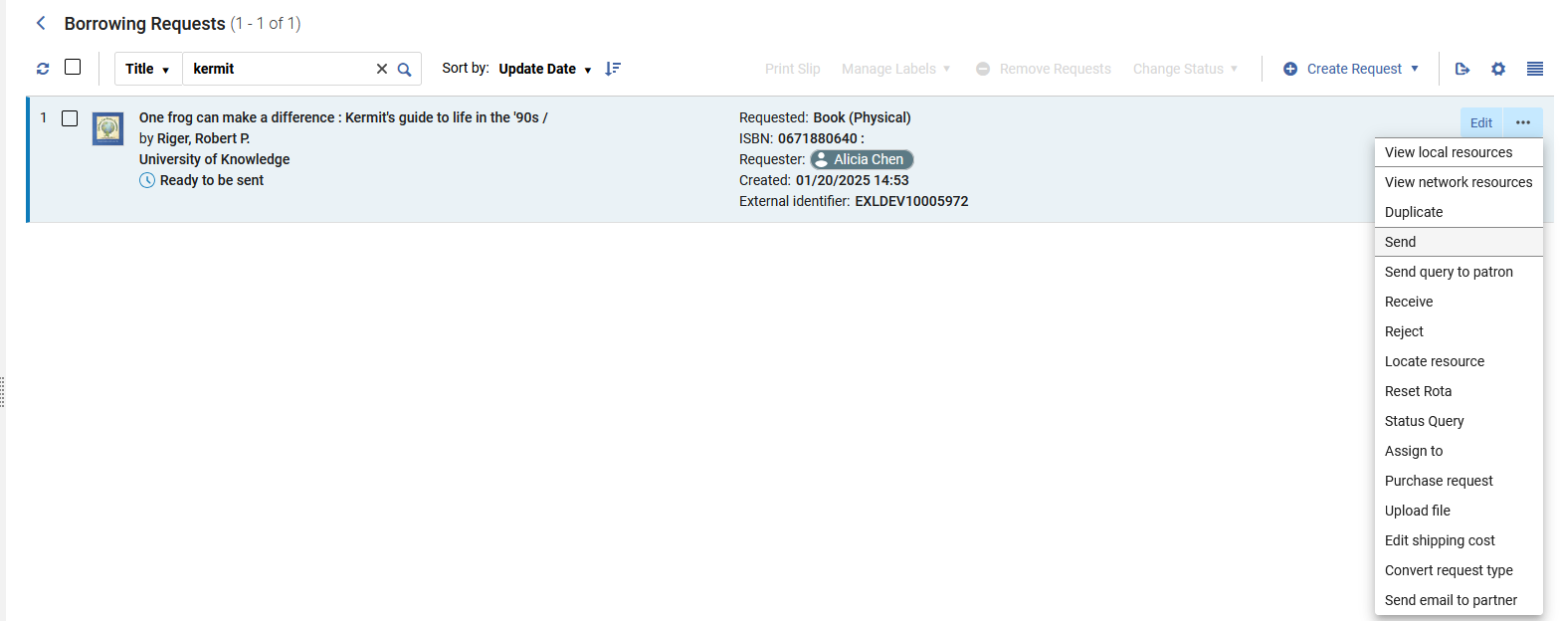
Flow for staff in Alma
Still in Alma University, the Borrowing request is sent

Slide 23
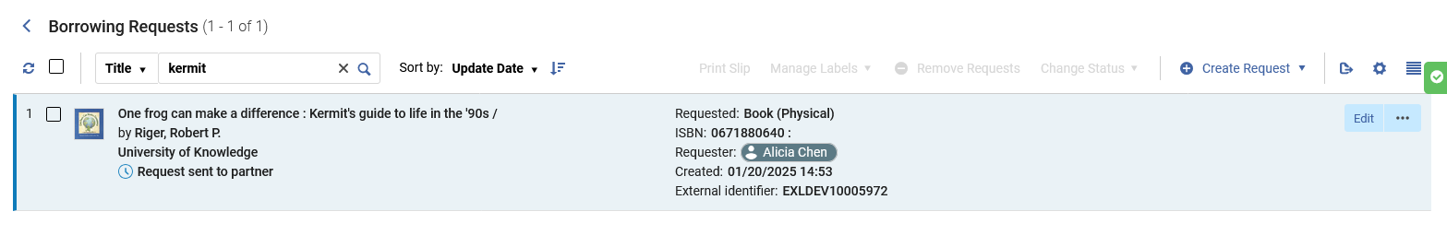
Flow for staff in Alma
Still in Alma University, the borrowing request has changed status to “Request sent to partner”

Slide 24

Flow for staff in Alma
Now in University of Knowledge (at the “Library and Information Science” circulation desk) the staff user accesses the lending request.
This can be accessed from either
“Fulfillment > Resource Sharing > Borrowing Requests”
OR
The “Resource Sharing requests” link on the top (This appears for institutions with Rapido)

Slide 25
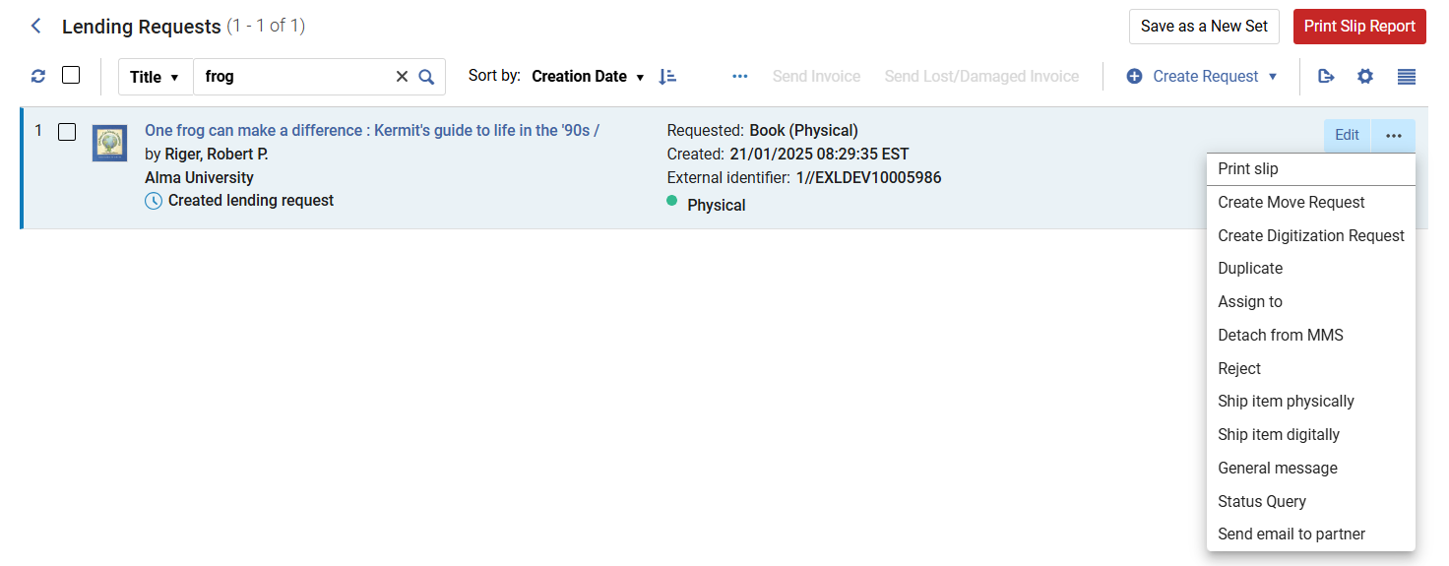
Flow for staff in Alma
Here is the resource sharing Lending Request in University of Knowledge
From here the staff user can print a slip (to retrieve item from shelf) or ship the item

Slide 26
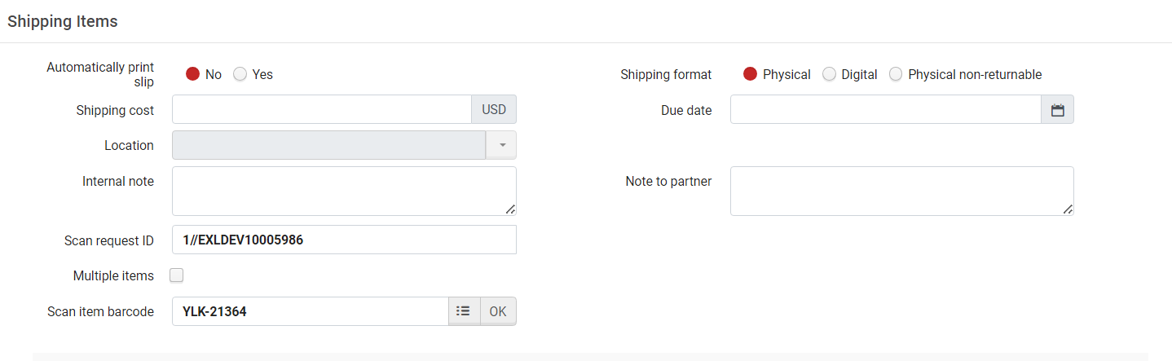
Flow for staff in Alma
The item can also be shipped from “Fulfillment > Resource Sharing > Shipping Items”.
We will use this option. We are at the “Library and Information Science” circulation desk.

Slide 27
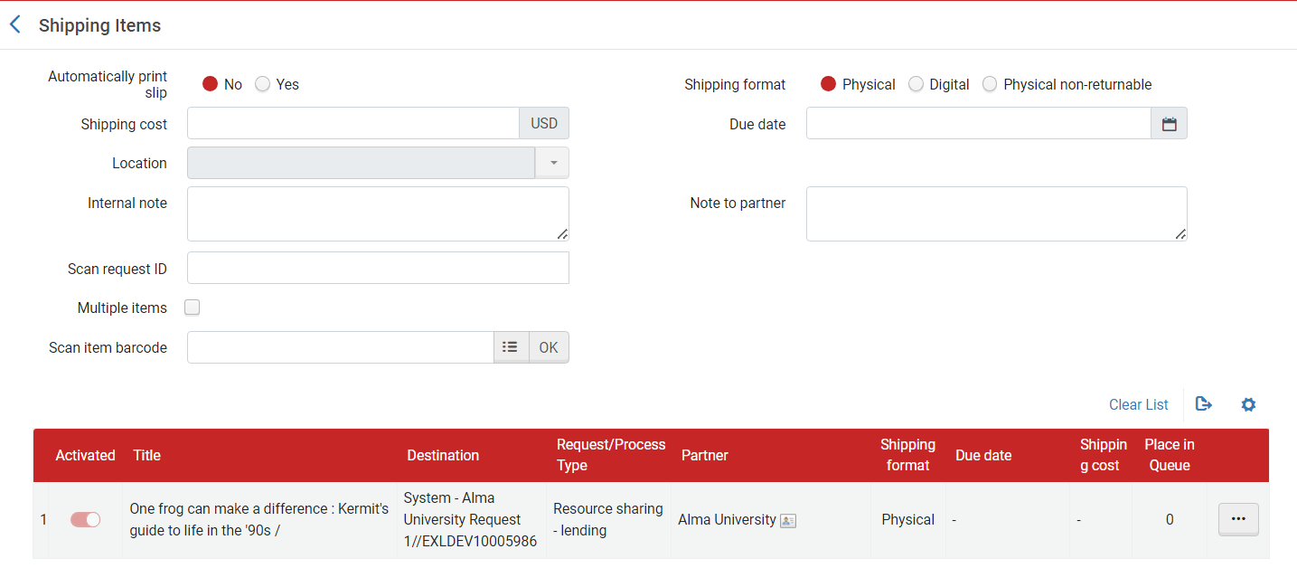
Flow for staff in Alma
After scanning the item in via “Fulfillment > Resource Sharing > Shipping Items” at University of Knowledge the destination will be “Alma University”.

Slide 28
Flow for staff in Alma
At Alma University the request now appears as status “Shipped Physically” (accessed at “Fulfillment > Resource Sharing > Borrowing Requests)
We will use the external identifier to scan it in soon

Slide 29
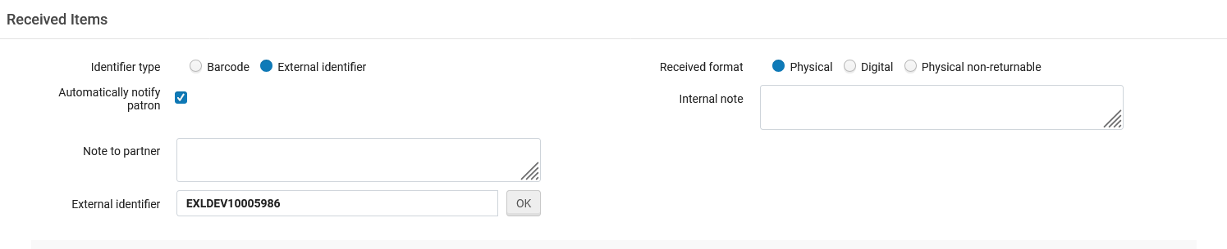
Flow for staff in Alma
The item arrives to institution Alma University and is scanned in at the Resource Sharing Desk (Fulfillment > Resource Sharing > Receiving Items)

Slide 30
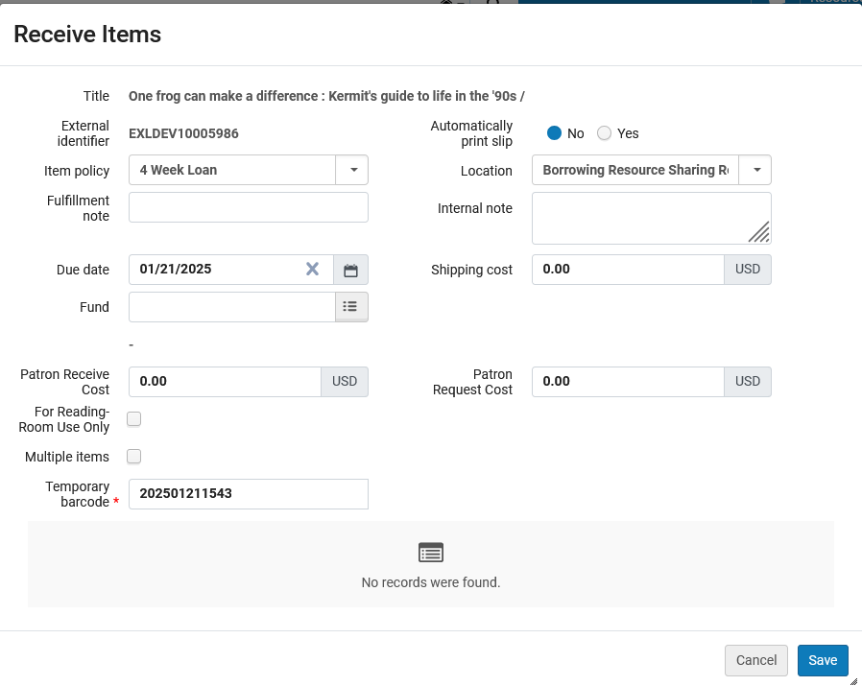
Flow for staff in Alma
Alma University gives it a temporary barcode and saves
Due date and item policy can be changed

Slide 31
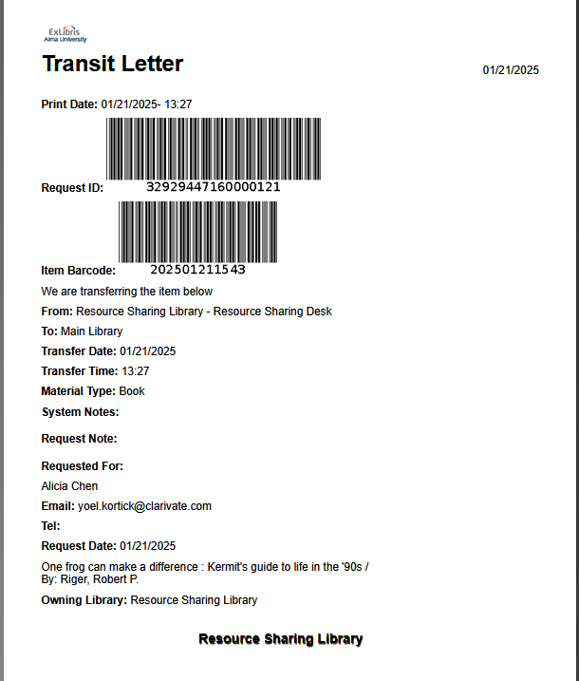
Flow for staff in Alma
Item needs to transfer to the Main Library to be loaned. A transit letter is printed.

Slide 32
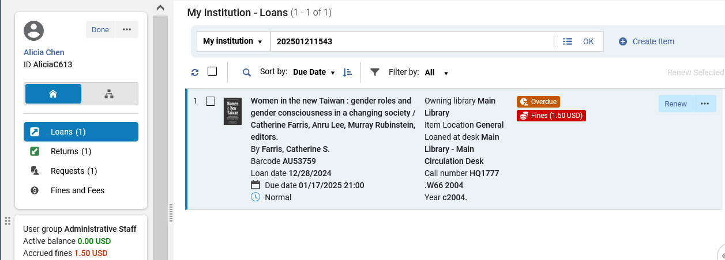
Flow for staff in Alma
Patron receives a notification that the item arrived and comes to the Main Library to loan the item (staff users loans the item from Main Library circulation desk like all loans via Fulfillment > Checkout/Checkin Manage Patron Services)

Slide 33
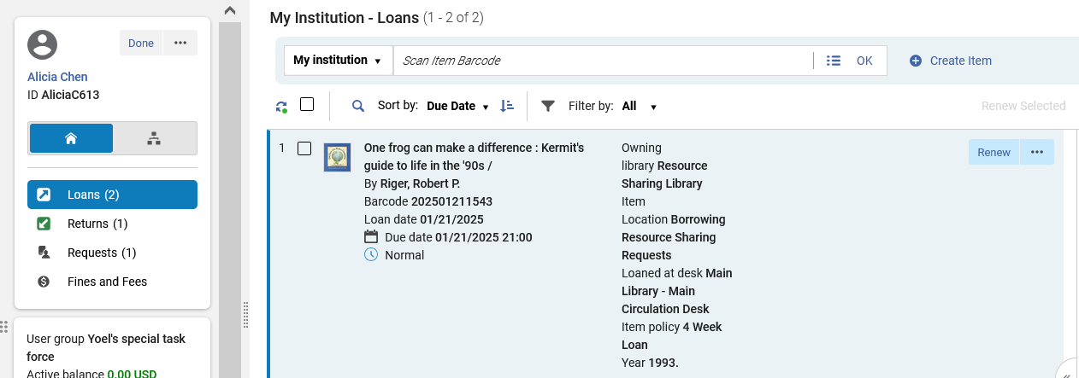
Flow for staff in Alma
Item is loaned

Slide 34
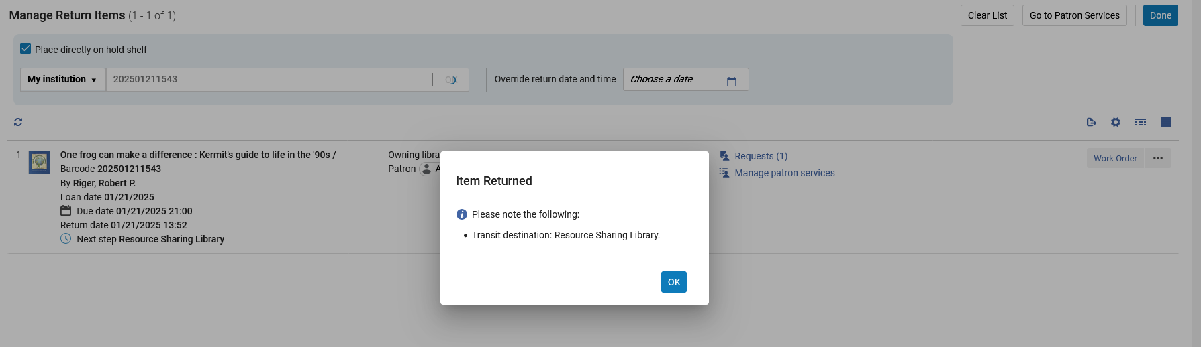
Flow for staff in Alma
Item is returned by patron at the Main Library circulation desk
Item will be transferred to the Resource Sharing library who will then ship it back to University of Knowledge

Slide 35
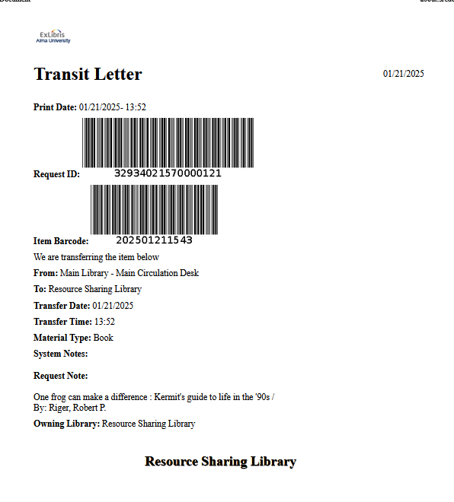
Flow for staff in Alma
When item is returned by patron at the Main Library circulation desk a transit letter is printed to transit the item to the Resource Sharing library

Slide 36
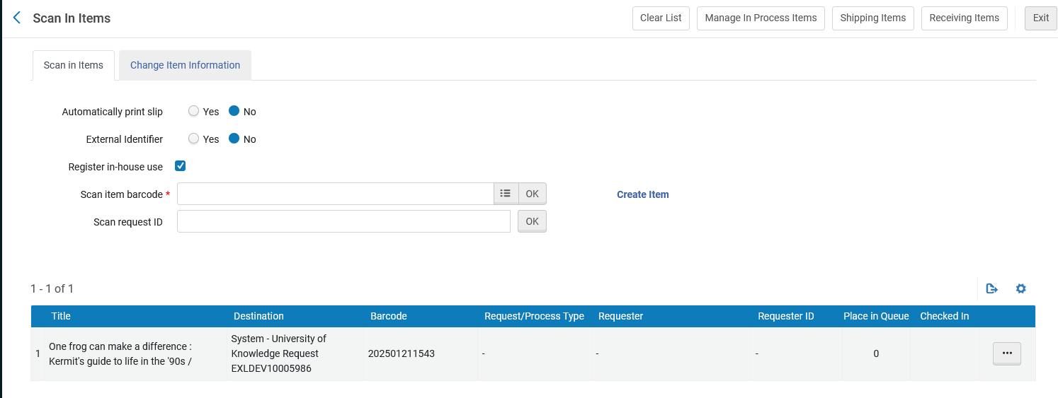
Flow for staff in Alma
Item is scanned in at the Alma University Resource Sharing library circulation desk (Fulfillment > Resource Requests > Scan in Items)
The destination is the owning institution University of Knowledge

Slide 37
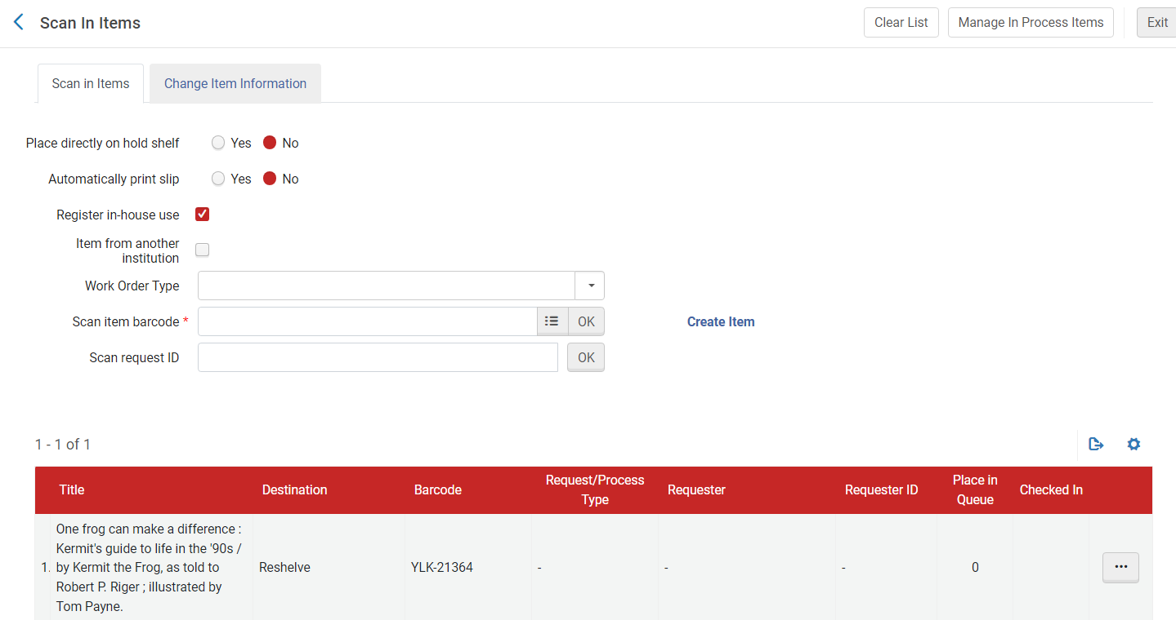
Flow for staff in Alma
Owning institution University of Knowledge receives the item and scans it in (with their own barcode). Here it is scanned in at the “Library and Information Science Library” circulation desk via “Fulfillment > Resource Requests > Scan In Items”

Slide 38
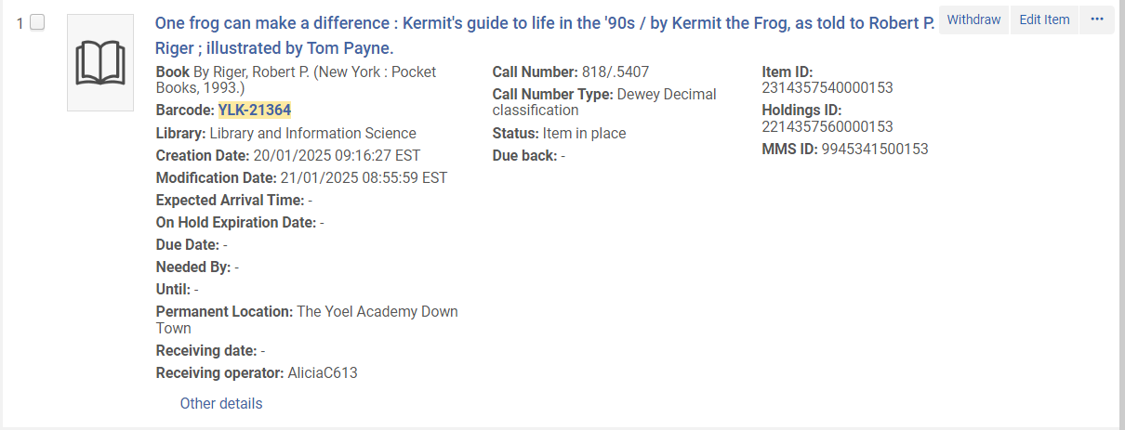
Flow for staff in Alma
At University of Knowledge the item is in place. The process is complete

